Slide 1
Course Name: Operating System
Course Code: 13005100
Memory Management Unit-2
Presented By: Ms. Sonam Pareek
Assistant Professor

Slide 2
Course Objective
To Understand the services provided by an operating system.
1. To acquire the fundamental knowledge of the operating system architecture and its components
2. To know the various operations performed by the operating system.
3. The Operating System will identify at which Time the CPU will perform which Operation and in which Time the Memory is used by which Programs.
4. Operating System Also Known as the Resource Manager Means Operating System will Manages all the Resources those are Attached to the System means all the Resource like Memory and Processor and all the Input output Devices those are Attached to the System

Slide 3
Basics Facts
Memory is a large array of words or bytes, each with its own address.
Memory management keeps track of each and every memory location - either it is allocated to some process or it is free.
It checks how much memory is to be allocated to processes.
It decides which process will get memory at what time.
It tracks whenever some memory gets freed or unallocated and correspondingly it updates the status.

Slide 4
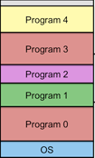
Early multi-programming systems used fixed partitions to allocate memory to user processes, each of which could hold a single process.

Slide 5
Cache Memory
Information is normally kept in some storage device (main memory)
When it is used it is copied into a faster storage system – cache, on a temporary basis.
Cache - A memory buffer added between CPU and main memory to accommodate speed differential .
When we need any information, we first check whether it is in cache. If it is in cache, we retrieve information directly from there. If it is not, we retrieve information from source and also put a copy in cache for future accesses.
Due to limited size of cache, cache management important.

Slide 6
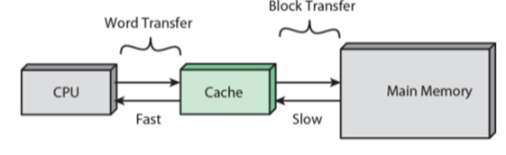
Cache and Main Memory

Slide 7
Protection Against Unauthorized Access
Protect operating system from access by user processes
Protect user processes from one another
Each process has to be assigned a separate memory space
A range of legal addresses that a process may access is determined and it is ensured that the process can access only these legal addresses

Slide 8
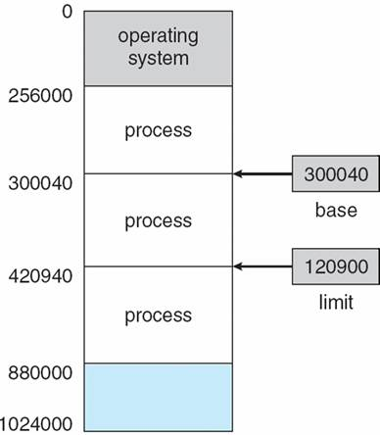
Base and Limit Register
Memory management provides protection by using two registers, a base register and a limit register.
The base register holds the smallest legal physical memory address and the limit register specifies the size of the range.
For example, if the base register holds 300040 and the limit register is 120900, then the program can legally access all addresses from 300040 through 420939 (300040 + 120900)

Slide 9
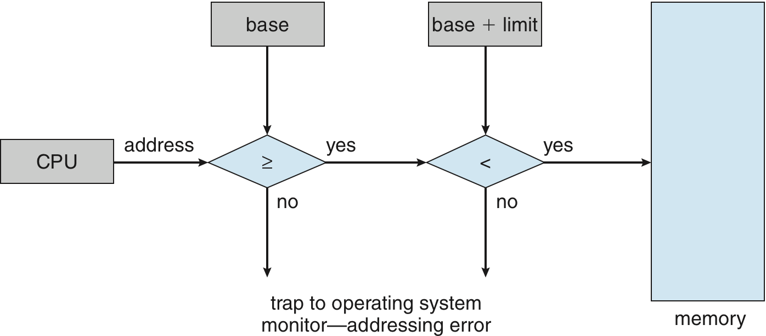
Any attempt by a program executing in user mode to access OS memory or other users memory results in a trap to OS, which treats the attempt as fatal error.
This prevents user program from modifying the code or data structure of OS

Slide 10
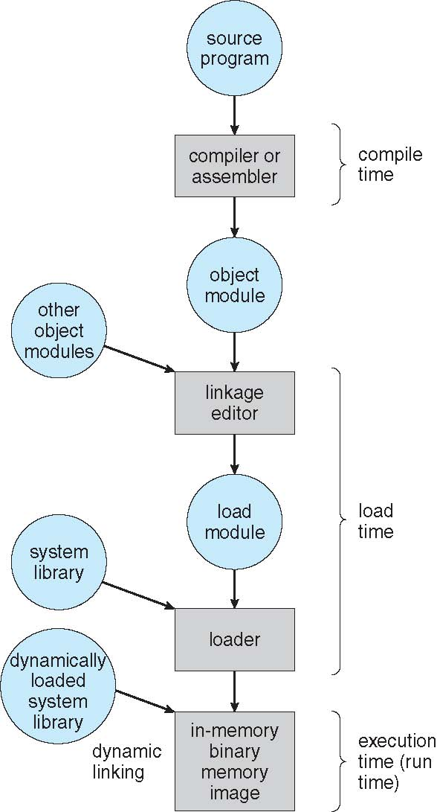
Address Binding
User programs go through several steps before being executed.
Addresses may be represented in different ways during these steps.
Source Program – Symbolic address
Compiler – relocatable address
Linker / loader – absolute address

Slide 11
Types of Addresses
Symbolic address
Ex. Variable names (such as i)
Relocatable address
A compiler typically binds symbolic address with relocatable address (in terms of offset)
Ex. 100 bytes from beginning of this module
Absolute address
The linkage editor or loader binds relocatable address to absolute address (physical address)
Ex. 74014

Slide 12
Address Binding
Compile time:
Known at compile time where the process will reside in memory
Generate absolute code
Need to recompile if starting location changes
Load time:
Not known at compile time where the process will reside in memory, then compiler must generate relocatable code
Converted to absolute address at the load time
Execution time:
Binding delayed until run time if the process can be moved during its execution from one memory segment to another
Need hardware support

Slide 13
Logical vs. Physical Address Space
Logical Address - generated by CPU (also called as virtual address)
Physical Address – address actually available on memory unit (loaded into memory address register)
Compile time & load time address-binding method generates identical logical & physical addresses.
Execution time address binding scheme results in different logical & physical addresses.
Logical Address Space – set of all logical addresses generated by a program.
Physical Address Space – set of all physical addresses corresponding to these logical addresses

Slide 14
Logical vs. Physical Address Space
Memory-management unit (MMU) – H/w device performs run-time mapping from virtual to physical address
In MMU scheme, the value in the relocation register is added to every address generated by a user process at the time it is sent to memory
The user program deals with logical addresses; it never sees the real physical addresses.

Slide 15
Dynamic Relocation using Relocation Register

Slide 16
Swapping
A process can be swapped temporarily out of memory to a backing store, and then brought back into memory for continued execution.
Backing store – fast disk large enough to accommodate copies of all memory images for all users; must provide direct access to these memory images.
Roll out, roll in – swapping variant used for priority-based scheduling algorithms; lower-priority process is swapped out so higher-priority process can be loaded and executed.
Major part of swap time is transfer time; total transfer time is directly proportional to the amount of memory swapped.
Ex- Process size = 100 MB; Hard disk transfer rate = 50MB/Sec.
Transfer Time (one way)= 100 MB / 50 MB = 2 Sec.

Slide 17
Schematic View of Swapping

Slide 18
Contiguous Allocation
Main memory usually has two partitions:
Resident operating system, usually held in low memory with interrupt vector.
User processes then held in high memory.
Memory Mapping & Protection
Relocation-register & limit register scheme used to protect user processes from each other, and from changing operating-system code and data.
Relocation register contains value of smallest physical address; limit register contains range of logical addresses

Slide 19
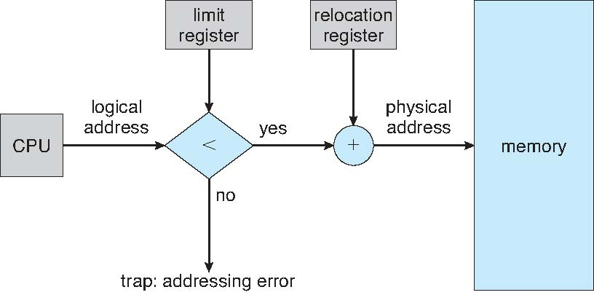
Hardware Support for Relocation and Limit Registers

Slide 20
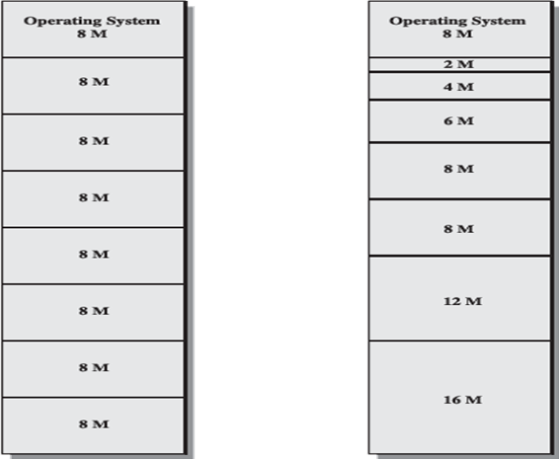
Contiguous Allocation
Fixed Size Partition
Variable Size Partition

Slide 21
Contiguous Allocation
Fixed-size partition
Divide memory into several fixed sized partition
Each partition may contain exactly one process
Degree of multiprogramming is bound by the number of partitions.
When partition is free process is selected from input queue & loaded into free partition.
When process terminates partition becomes available to other process

Slide 22
Contiguous Allocation
Variable Partition
OS keeps table indicating which parts of memory are available & which are occupied.
Operating system maintains information about: a) allocated partitions b) free partitions (hole)
Hole – block of available memory; holes of various size are scattered throughout memory.
When a process arrives, it is allocated memory from a hole large enough to accommodate it.

Slide 23
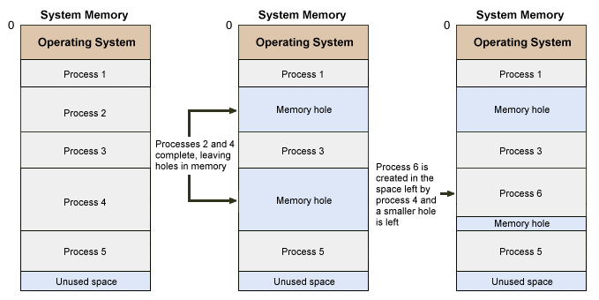

Slide 24
Dynamic Storage-Allocation Problem
How to satisfy a request of size n from a list of free holes.
There are following solutions to this problem:
First-fit: Allocate the first hole that is big enough.
Best-fit: Allocate the smallest hole that is big enough; must search entire list. Produces the smallest leftover hole.
Worst-fit: Allocate the largest hole; must also search entire list. Produces the largest leftover hole.
First-fit and best-fit better than worst-fit in terms of speed and storage utilization.

Slide 25
Paging
Memory management scheme that permits physical address space and Logical address space of a process to be noncontiguous.
Divide physical memory into fixed-sized blocks called frames.
Divide logical memory into fixed-sized blocks called pages.
Page size = frame size
Keep track of all free frames.
When process needs to be executed, its pages are loaded into any available memory frames

Slide 26
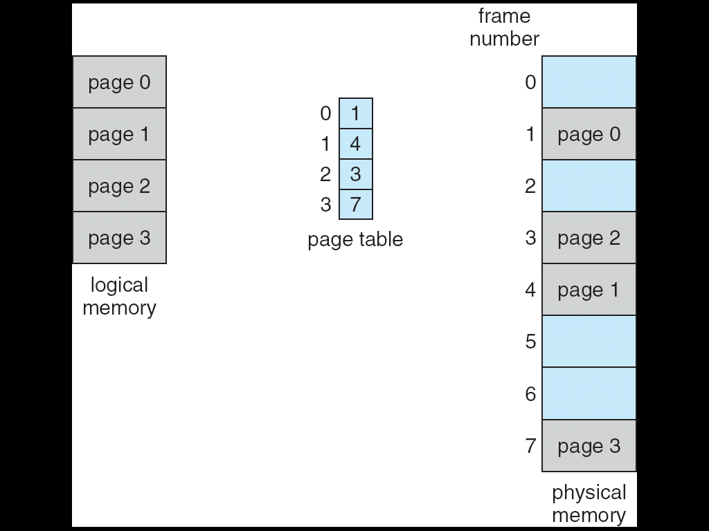
Paging Model of Logical and Physical Memory

Slide 27
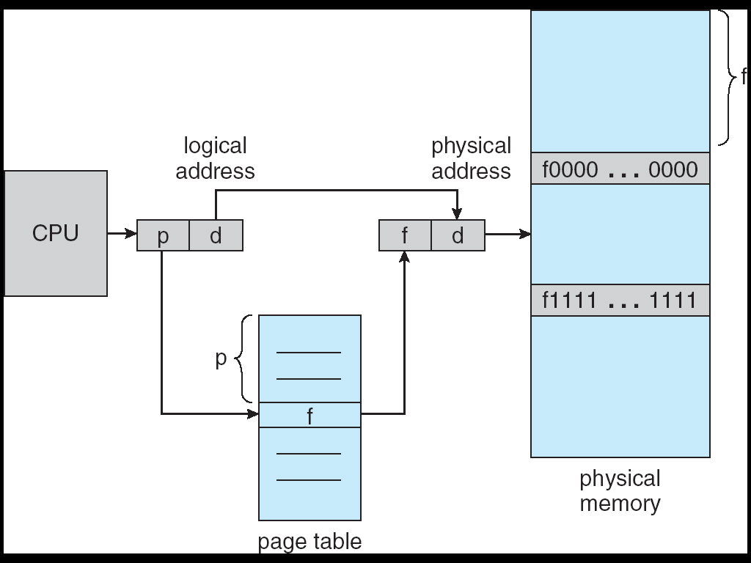
Address generated by CPU is divided into:
Page number (p) – used as an index into a page table which contains base address of each page in physical memory.
Page offset (d) – combined with base address to define the physical memory address that is sent to the memory unit.

Slide 28
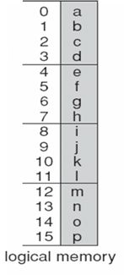
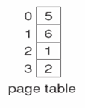
Paging example for 32 byte memory with 4 byte pages.
Page No.
Physical Address = [(frame No. * page size)
+ offset ]
0
1
0
2
Logical address 0 (page0 ,offset 0)map to physical address 20[= (5*4)+0].
Logical address 3(page 0, offset 3) maps to physical address 23[= (5*4)+3].
Logical address 4 (page 1, offset 0) maps to physical address 24[= (6*4)+0].
Logical address 13 (page 3, offset 1)maps to physical address 9[= (2*4)+1]
1
3
2
4
3
5
6
7

Slide 29
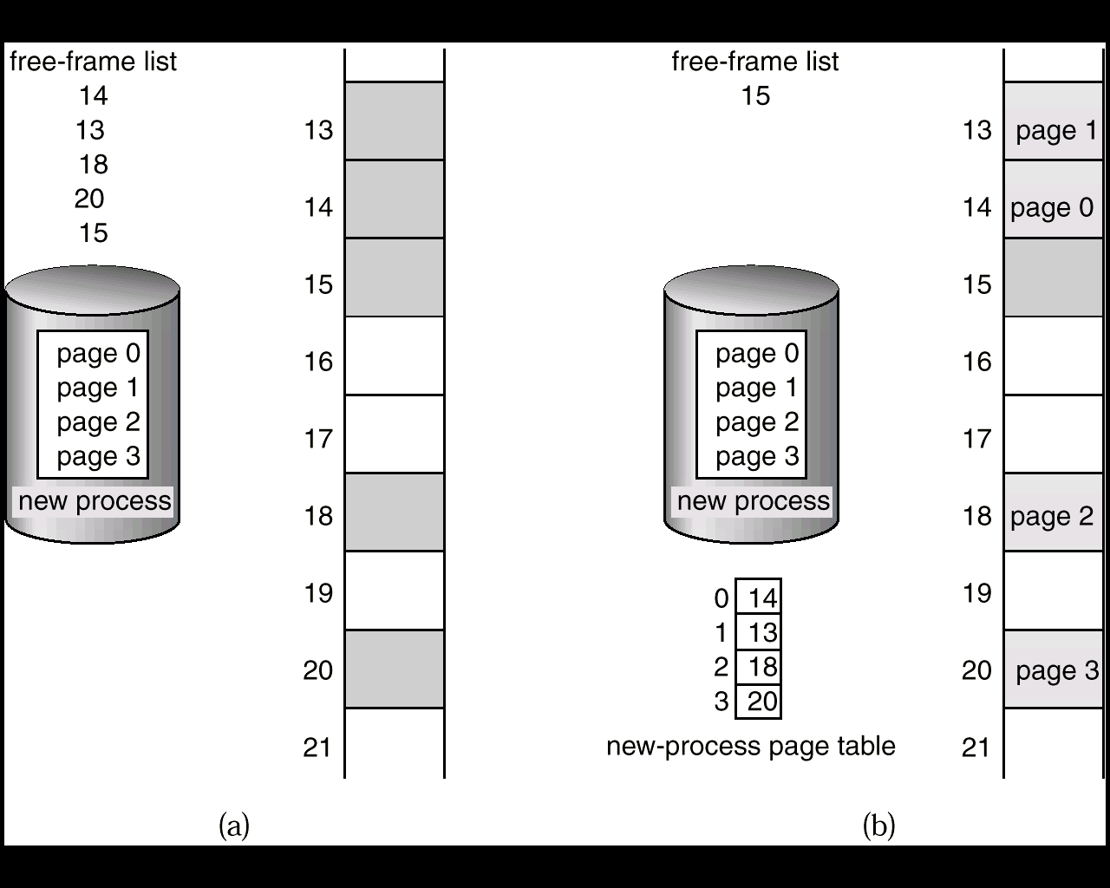
Free Frames (a) Before and (b)after allocation

Slide 30
Segmentation
A program is a collection of segments
A segment is a logical unit such as: main program, procedure , function, method, object, local variables, global variables, common block, stack, symbol table, arrays
Segmentation is a technique to break memory into logical pieces (of variable sizes) where each piece represents a group of related information
Logical address consists of a two tuple:
<segment-number, offset>
Offset should be less than length of the segment

Slide 31
Segment table – maps two-dimensional user defined address into one dimensional physical address
Each table entry has:
Segment base – starting physical address where the segments reside in memory
Segment limit – specifies the length of the segment

Slide 32
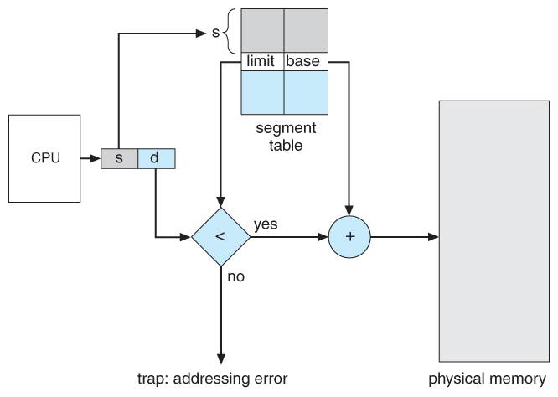
Segmentation Hardware

Slide 33
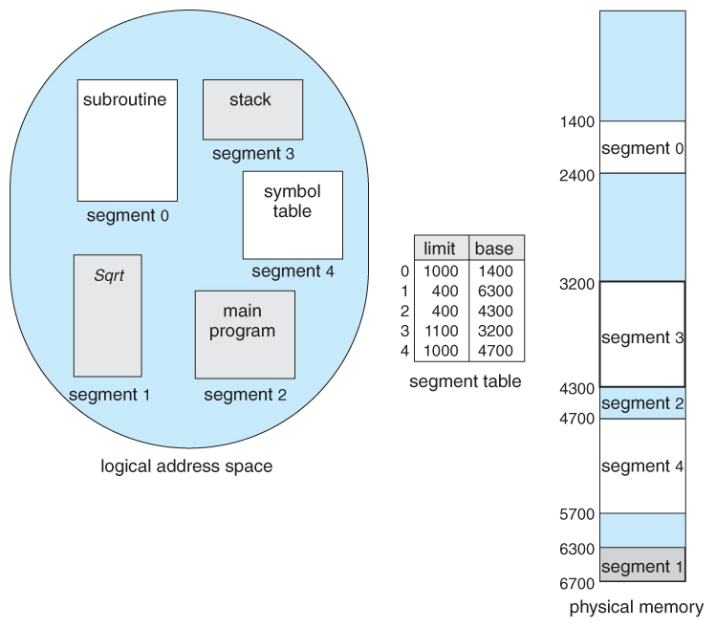
Example
Logical Address | Physical Address
Byte 53 of segment 2 | 4353 (4300+53)
Byte 852 of segment 3 | 4052 (3200+852)
Byte 1222 of segment 0 | Invalid address – trap to OS

Slide 34
Paging vs. Segmentation
Paging | Segmentation
Program is divided into fixed sized pages | Program is divided into variable size segments
Division of pages is performed by the OS and is transparent to the user | User (or compiler) is responsible for dividing program into segments.
It has only one linear address space. | It has many address spaces. In segmentation, the address space is typically divided into a preset number of segments like data segment (read/write), code segment(read-only), stack(read/write) etc.
A page is a physical unit | A segment is a logical unit

Slide 35
Virtual Memory

Slide 36
Virtual Memory
Virtual memory is a technique that allows the execution of processes that may not be completely in main memory.
Programmers get illusion of much larger memory than actual physical memory.
It is a separation of user logical memory from physical memory.
This separation allows an extremely large virtual memory to be provided for programmers when only a smaller physical memory is available.

Slide 37
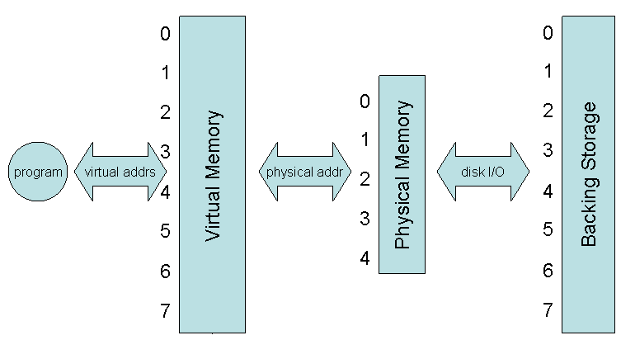
Virtual Memory That is Larger Than Physical Memory

Slide 38
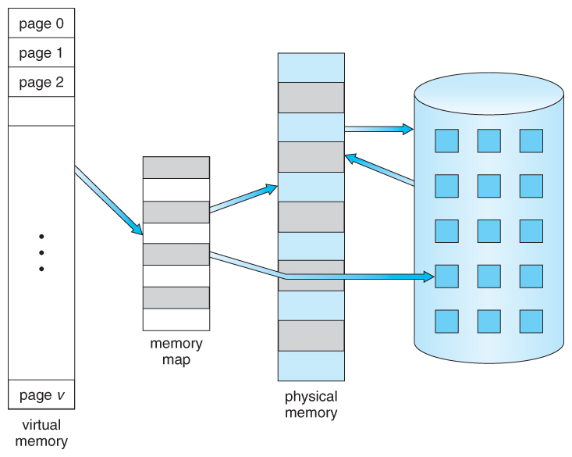
Virtual Memory That is Larger Than Physical Memory

Slide 39
Advantages of Virtual Memory
The size of the user’s program is not constrained by the available size of physical memory.
Increase in CPU utilization and throughput.
Less I/O is needed to load or swap user programs into memory, so each user program runs faster.

Slide 40
Demand Paging
Virtual memory is commonly implemented by demand paging
Bring a page into memory only when it is needed i.e. only on demand, not in advance.
For process to be executed, it is swapped into memory.
Lazy Swapper – never swaps a page into memory unless that page is needed.
Swapper that deals with pages is a Pager

Slide 41
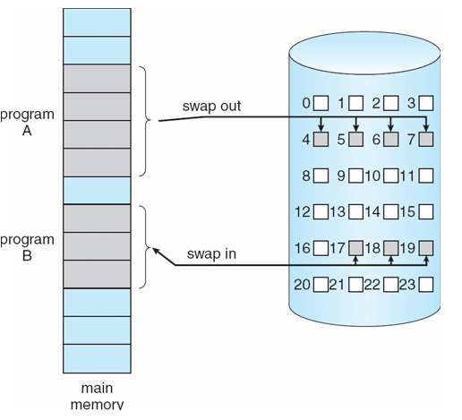
Transfer of a Paged Memory to Contiguous Disk Space

Slide 42
Valid-Invalid Bit Scheme
Used to distinguish between the pages that are in memory & the pages that are on the disk.
With each page table entry a valid–invalid bit is associated
(v ⇒ in-memory, i ⇒ not-in-memory)
Initially all page entries marked invalid. When brought in physical memory, marked valid
Marking a page invalid will have no effect if process never attempts to access that page
If process tries to access a page marked invalid causes a page fault.

Slide 43
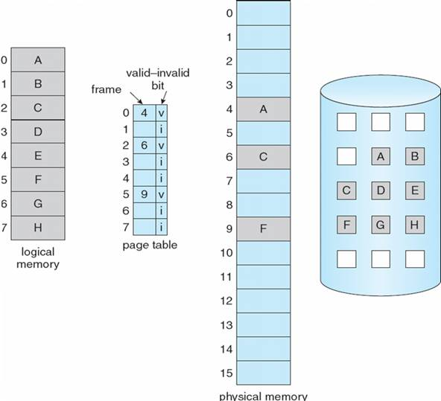
Page Table When Some Pages Are Not in Main Memory

Slide 44
Page Fault
If there is a reference to a page that was not brought into memory, it will trap to operating system
Procedure for handling page fault :
Check internal table to determine whether reference was invalid or valid
Invalid reference → terminate the process
Find free frame.
Schedule a disk operation to read the desired page into the newly allocated frame.
When disk read is complete, modify the internal table & page table to indicate that the page is in the memory.
Restart the instruction that was interrupted by the trap. Process can now access the page.

Slide 45
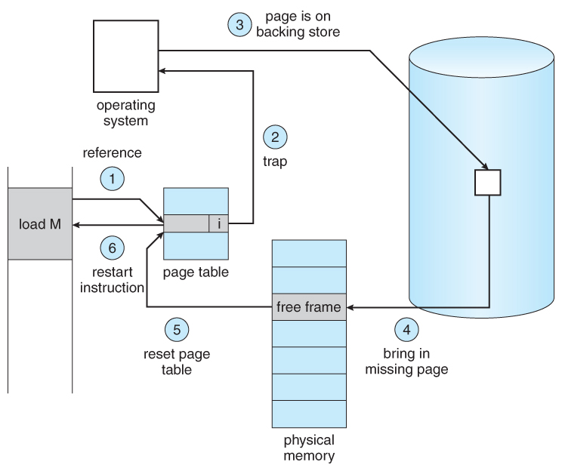
Steps in Handling a Page Fault

Slide 46
Basic Page Replacement
Find the location of the desired page on disk.
Find a free frame:
If there is a free frame, use it
If there is no free frame, use a page replacement algorithm to select a victim frame.
Bring the desired page into the (newly) free frame; update the page and frame tables.
Restart the process.

Slide 47
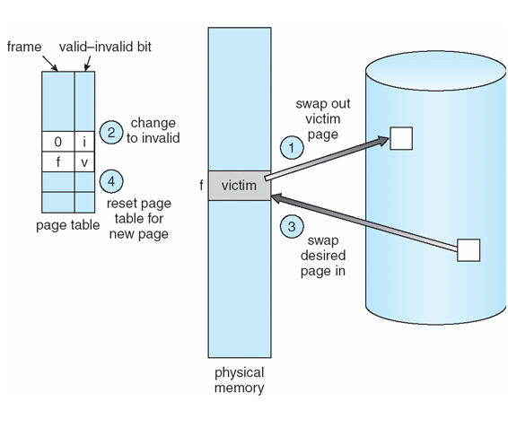
Page Replacement

Slide 48
Dirty Bit
If no frames are free, two page transfers are required
Contents of page being swapped out have to be written back to disk
Each page has a modify bit associated with it
Modify bit for a page is set whenever any word/byte in the page is written into
Use modify (dirty) bit to reduce overhead of page transfers – while swapping out only modified pages are written to disk

Slide 49
Page Replacement Algorithms
Lowest page-fault rate
Evaluate algorithm by running it on a particular string of memory references (reference string) and computing the number of page faults on that string.
Generally as the number of frames available increases, the number of page fault decreases.

Slide 50
FIFO Page Replacement
Oldest page is chosen to be replaced.
Create a FIFO queue to hold all pages in the memory.
Replace the page at the head of the queue
When a page is brought into memory, insert it at the tail of the queue.
Ex. :
Memory with 3 frames (3 pages can be in memory at a time per process)
How many page faults will occur ?

Slide 51
7
7
7
0
1
2
3
0
4
2
3
0
1
2
7
0
0
1
2
3
0
4
2
3
0
1
2
7
0
1
2
3
0
4
2
3
0
1
2
7
0
1
Page-fault=15
Fault rate =15 / 20 = 0.75 (no. of faults / total no. of accesses)

Slide 52
First-In-First-Out (FIFO) Algorithm
Reference String – 3 frames
1, 2, 3, 4, 1, 2, 5, 1, 2, 3, 4, 5
Number of page faults = 9
Reference String – 4 frames
1, 2, 3, 4, 1, 2, 5, 1, 2, 3, 4, 5
Number of page faults = 10
1
1
1
2
3
4
1
2
5
1
1
1
1
2
3
4
5
1
2
2
2
3
4
1
2
5
3
2
2
2
3
4
5
1
2
3
3
4
1
2
5
3
4
3
3
4
5
1
2
3
4
4
5
1
2
3
4
5
Belady’s anomaly : page fault may increase as the no. of allocated frames increases.

Slide 53
Optimal Page Replacement
Replace page that will not be used for longest period of time
It has the lowest page-fault rate of all algorithms.
It will never suffer from Belady’s anomaly.
Difficult to implement as it requires future knowledge of reference string
7
7
7
2
2
2
2
2
7
0
0
0
0
4
0
0
0
1
1
3
3
3
1
1
Page-fault = 9

Slide 54
Question – Optimal Page Replacement
For the following reference string how many page faults will occur for memory with 3 frames ?
1, 2, 3, 4, 1, 2, 5, 1, 2, 3, 4, 5
7 page fault

Slide 55
Least Recently Used (LRU) Algorithm
Replace the page that has not been used for the longest period of time.
7
7
7
2
2
4
4
4
0
1
1
1
0
0
0
0
0
0
3
3
3
0
0
1
1
3
3
2
2
2
2
2
7
12 page fault

Slide 56
Practice Question 1
Reference String – 0, 9, 0, 1, 8, 1, 8, 7, 8, 7, 1, 2, 8, 2, 7, 8, 2, 3, 8, 3
3 frames

Slide 57
Page | Fault | After
0 | * | 0,-,-
9 | * | 0,9,-
0 |  | 0,9,-
1 | * | 0,9,1
8 | * | 9,1,8
1 |  | 9,1,8
8 |  | 9,1,8
7 | * | 1,8,7
8 |  | 1,8,7
7 |  | 1,8,7
1 |  | 1,8,7
2 | * | 8,7,2
8 |  | 8,7,2
2 |  | 8,7,2
7 |  | 8,7,2
8 |  | 8,7,2
2 |  | 8,7,2
3 | * | 7,2,3
8 | * | 2,3,8
3 |  | 2,3,8
Page | Fault | After
0 | * | 0,-,-
9 | * | 0,9,-
0 |  | 0,9,-
1 | * | 0,9,1
8 | * | 9,1,8
1 |  | 9,1,8
8 |  | 9,1,8
7 | * | 1,8,7
8 |  | 1,8,7
7 |  | 1,8,7
1 |  | 1,8,7
2 | * | 8,7,2
8 |  | 8,7,2
2 |  | 8,7,2
7 |  | 8,7,2
8 |  | 8,7,2
2 |  | 8,7,2
3 | * | 8,2,3
8 |  | 8,2,3
3 |  | 8,2,3
Page | Fault | After
0 | * | 0,-,-
9 | * | 0,9,-
0 |  | 0,9,-
1 | * | 0,9,1
8 | * | 0,1,8
1 |  | 0,1,8
8 |  | 0,1,8
7 | * | 1,8,7
8 |  | 1,8,7
7 |  | 1,8,7
1 |  | 1,8,7
2 | * | 1,7,2
8 | * | 1,2,8
2 |  | 1,2,8
7 | * | 2,8,7
8 |  | 2,8,7
2 |  | 2,8,7
3 | * | 2,8,3
8 |  | 2,8,3
3 |  | 2,8,3
FIFO
8 faults
Optimal
7 faults
LRU
9 faults

Slide 58
Practice Question 2
Reference String – 0,1,4,2,0,2,6,5,1,2,3,2,1,2,6,2,1,3,6,2
3 frames

Slide 59
Page | Fault | After
0 | * | 0,-,-
1 | * | 0,1,-
4 | * | 0,1,4
2 | * | 1,4,2
0 | * | 4,2,0
2 |  | 4,2,0
6 | * | 2,0,6
5 | * | 0,6,5
1 | * | 6,5,1
2 | * | 5,1,2
3 | * | 1,2,3
2 |  | 1,2,3
1 |  | 1,2,3
2 |  | 1,2,3
6 | * | 2,3,6
2 |  | 2,3,6
1 | * | 3,6,1
3 |  | 3,6,1
6 |  | 3,6,1
2 | * | 6,1,2
Page | Fault | After
0 | * | 0,-,-
1 | * | 0,1,-
4 | * | 0,1,4
2 | * | 0,1,2
0 |  | 0,1,2
2 |  | 0,1,2
6 | * | 1,2,6
5 | * | 1,2,5
1 |  | 1,2,5
2 |  | 1,2,5
3 | * | 1,2,3
2 |  | 1,2,3
1 |  | 1,2,3
2 |  | 1,2,3
6 | * | 1,2,6
2 |  | 1,2,6
1 |  | 1,2,6
3 | * | 2,6,3
6 |  | 2,6,3
2 |  | 2,6,3
Page | Fault | After
0 | * | 0,-,-
1 | * | 0,1,-
4 | * | 0,1,4
2 | * | 1,4,2
0 | * | 4,2,0
2 |  | 4,2,0
6 | * | 2,0,6
5 | * | 2,6,5
1 | * | 6,5,1
2 | * | 5,1,2
3 | * | 1,2,3
2 |  | 1,2,3
1 |  | 1,2,3
2 |  | 1,2,3
6 | * | 1,2,6
2 |  | 1,2,6
1 |  | 1,2,6
3 | * | 1,2,3
6 | * | 1,3,6
2 | * | 3,6,2
FIFO
13 faults
Optimal
9 faults
LRU
14 faults

Slide 60
Practice Question 3
Reference String – 1,1,2,3,4,1,2,3,1,0,2
3 frames

Slide 61
Page | Fault | After
1 | * | 1, -,-
1
2 | * | 1,2,-
3 | * | 1,2,3
4 | * | 2,3,4
1 | * | 3,4,1
2 | * | 4,1,2
3 | * | 1,2,3
1
0 | * | 2,3,0
2
Page | Fault | After
1 | * | 1,-,-
1
2 | * | 1,2,-
3 | * | 1,2,3
4 | * | 1,2,4
1
2
3 | * | 1,2,3
1
0 | * | 2,3,0
2
Page | Fault | After
1 | * | 1,-,-
1
2 | * | 1,2,-
3 | * | 1,2,3
4 | * | 2,3,4
1 | * | 3,4,1
2 | * | 4,1,2
3 | * | 1,2,3
1
0 | * | 1,3,0
2 | * | 1,0,3
FIFO
8 faults
Optimal
6 faults
LRU
9 faults

Slide 62
Allocation of Frames
Each process needs minimum number of frames
Equal allocation
For example, if there are 93 frames (after allocating frames for the OS) and 5 processes, give each process 18 frames. ( 3 leftover frames used as free frame pool)
But processes have different memory requirement
Proportional allocation
Allocate according to the size of process
Allocation changes with degree of multiprogramming

Slide 63
Global vs. Local Allocation
Global replacement – process selects a replacement frame from the set of all frames; one process can take a frame from another
Local replacement – each process selects from only its own set of allocated frames

Slide 64
Thrashing
A process is thrashing if it is spending more time paging than executing.
Ex. In case of global page replacement, a process needs more frames, faults and takes frames from other processes.
These processes also fault and in turn take frames from other processes
As processes queue up for paging device, ready queue empties, CPU utilization decreases.
CPU scheduler increases degree of multiprogramming on seeing empty ready queue – further page faults - thrashing

Slide 65
How big should a page be?
 Smaller pages have advantages 
Less internal fragmentation 
Better fit for various data structures, code sections 
Less unused physical memory (some pages have 20 useful bytes and the rest isn’t needed currently) 
Larger pages are better because 
Less overhead to keep track of them 
Smaller page tables 
TLB can point to more memory (same number of pages, but more memory per page) 
Faster paging algorithms (fewer table entries to look through) 
More efficient to transfer larger pages to and from disk

Slide 66
Thank You

